Slide 1

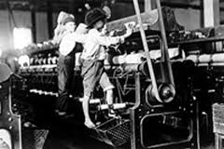
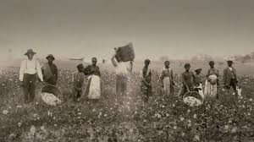
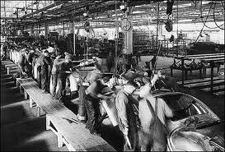
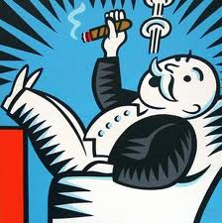
New Box = a new society without capitalism?

Slide 2


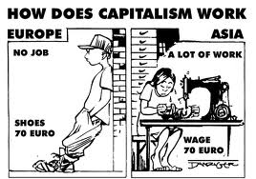
The Box:
a racist society
based on a
capitalist economy.

Slide 3



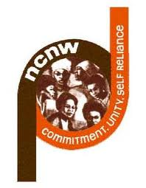



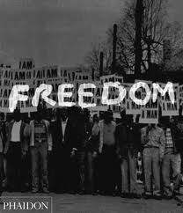
20th Century Civil Rights Organizations
NAACP: National Association for the Advancement of Colored People
NUL: National Urban League
NCNW: National Council of Negro Women
CORE: Congress of Racial Equality
SCLC: Southern Christian Leadership Conference
SNCC: Student Nonviolent Coordinating Committee

Slide 4

Out the BOX:
Migration:
movement through
physical space
Political culture:
ideological and
cultural change
Agency:
Icons and paradigms
as social movement infrastructure

Slide 5
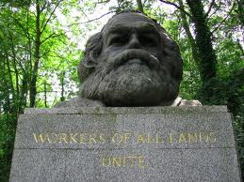

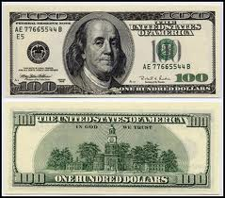
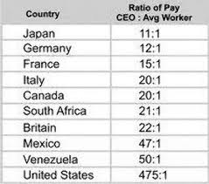
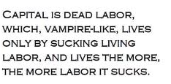
Marx, Capital
(1848, 1864)
Toward a theory of a new Box,
a theory of historical development
based on revolutionary class struggle

Slide 6
Foundation of modern industry is exploitation of Black labor
Direct slavery is just as much the pivot of bourgeois industry as machinery, credits, etc. Without slavery you have no cotton; without cotton you have no modern industry. It is slavery that has given the colonies their value; it is the colonies that have created world trade, and it is world trade that is the pre-condition of large-scale industry. Thus slavery is an economic category of the greatest importance. Without slavery North America, the most progressive of countries, would be transformed into a patriarchal country. Wipe out North America from the map of the world, and you will have anarchy--the complete decay of modern commerce and civilization. Cause slavery to disappear and you will have wiped America off the map of nations. Thus slavery, because it is an economic category, has always existed among the institutions of the peoples. Modern nations have been able only to disguise slavery in their own countries, but they have imposed it without disguise upon the New World. (Marx)

Slide 7

SOCIALISM - A society run by the working class (i.e., proletariat) rather than the bourgeoisie (i.e., capitalists). The state machine is used to defend working class interests against those who still have wealth or power and who will attempt to return society to the capitalist system and bourgeois rule. Socialism is the period of transition between the overthrow of bourgeois rule and the development of a classless, communist society. COMMUNISM - A classless society with no exploitation. No state machine used by one section of the population to oppress another section. No need for professional armies or police forces. No use of production for profit or exchange. Society runs in accord with the principle: From each according to his ability, to each according to his need.

Slide 8
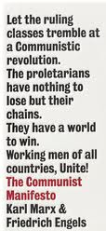
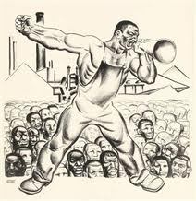
Black and White, Unite and Fight!
The people united will never be defeated!

Slide 9
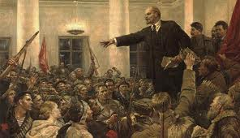
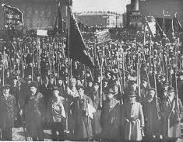
“It is the duty of the revolution to put an end to compromise, and to put an end to compromise means taking the path of socialist revolution.”
The goal of socialism
is communism.
“Monopolies, oligarchy, the striving for domination and not for freedom, the exploitation of an increasing number of small or weak nations by a handful of the richest or most powerful nations — all these have given birth to those distinctive characteristics of imperialism which compel us to define it as parasitic or decaying capitalism…. When nine-tenths of Africa had been seized (by 1900), when the whole world had been divided up, there was inevitably ushered in the era of monopoly possession of colonies and, consequently, of particularly intense struggle for the division and the redivision of the world.”
Lenin (1917)

Slide 10
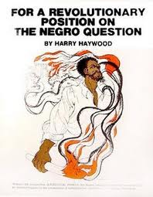
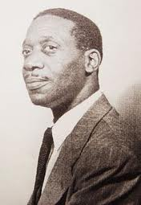
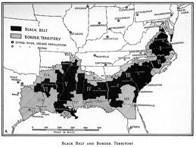
Communist International, 1928
…the Communist Party must come out as the champion of the right of the oppressed Negro race for full emancipation. While continuing and intensifying the struggle under the slogan of full social and political equality for the Negroes, which must remain the central slogan of our Party for work among the masses, the Party must come out openly and unreservedly for the right of the Negroes to national self-determination in the southern states, where the Negroes form a majority of the population. The struggle for equal rights and the propaganda for the slogan of self-determination must be linked up with the economic demands of the Negro masses, especially those directed against the slave remnants and all forms of national and racial oppression. Special stress must be laid upon organizing active resistance against Iynching, Jim Crowism, segregation and all other forms of oppression of the Negro population.
Harry Haywood
1898 - 1995

Slide 11
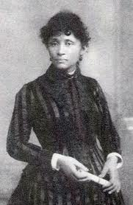
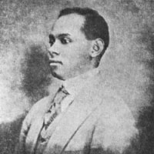
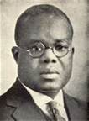


Early African American fighters for a
new Box: Lucy Parsons, Cyril Briggs,
George Woodbey, Richard Moore,
And Hubert Harrison

Slide 12
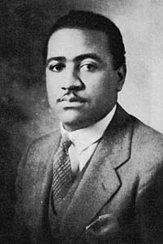
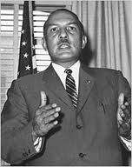
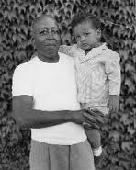
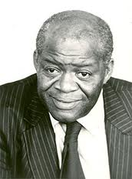
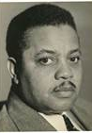
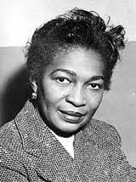
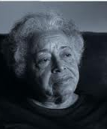
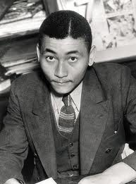
CPUSA
Ben Davis (1903-1964)
James Jackson (1914-1993)
Pettis Perry (1897-1965)
Henry Winston (1911-1986)
Black leaders of the Communist Party USA
James Ford (1893-1957)
Claudia Jones (1915-1964)
Louise Thompson Patterson (1901-1999)
Angelo Herndon (1913-1997)

Slide 13
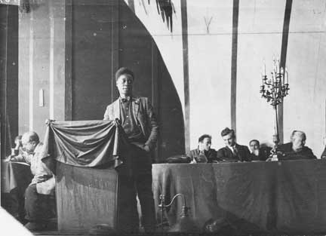
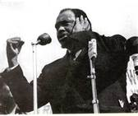
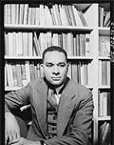
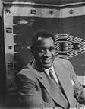
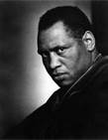
Some Black artists dedicated their work to fighting for a new box.

Slide 14
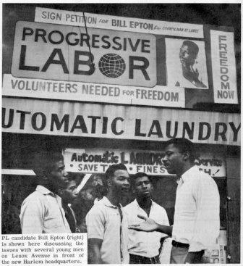
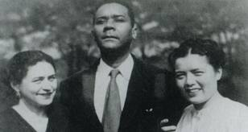

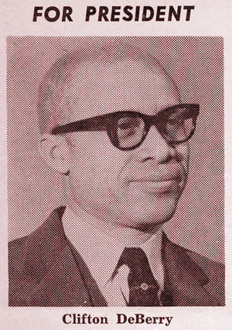

Followers of Trotsky
some left the CPUSA
Raya Dunayevskaya, C.L.R. James, and Grace Lee Boggs
Activist who left
CPUSA to support
Peoples Republic
of China

Slide 15

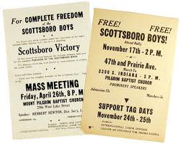
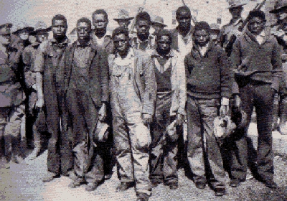
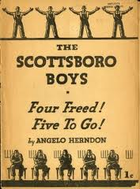

Communists led this struggle

Slide 16
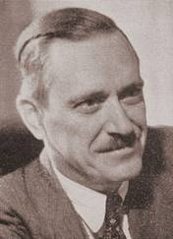
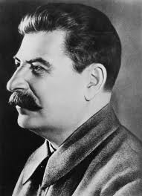


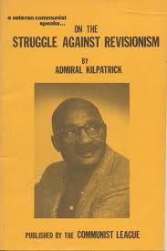
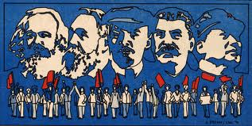
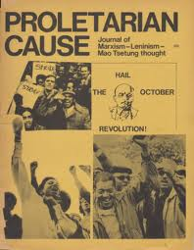
Earl Browder
(1881-1973)
Joseph Stalin
(1887-1953)
Stalin became the target
of capitalism against the
communism movements.
Browder led the CPUSA to
liquidate because he supported US capitalism!

Slide 17

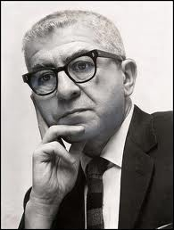
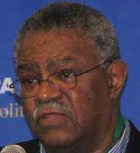




Slide 18
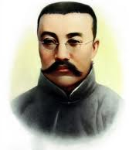
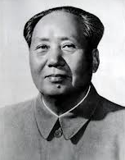
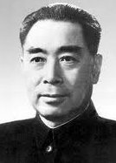




China
中国
Party formed
Socialist transformation begins
1978 Capitalist transformation begins

Slide 19




China: the struggle under socialism
Cultural Revolution (1966 – 1976)
Great Leap Forward (1958 – 1961)
Counter-revolution 1978
It will take a long period to decide the issue in the ideological struggle between socialism and capitalism in our country. The reason is that the influence of the bourgeoisie and of the intellectuals who come from the old society will remain in our country for a long time to come, and so will their class ideology. If this is not sufficiently understood, or is not understood at all, the gravest mistakes will be made and the necessity of waging the struggle in the ideological field will be ignored. (Mao)

Slide 20



China: the struggle continues today
China's billionaires double in number
China's ultra-rich continue to multiply rapidly, with the number of dollar billionaires on the latest rich list doubling in just two years.
The Hurun rich list, which has been tracking China's tycoons since 1999, on Wednesday said it had counted 271 dollar billionaires in China last year, up from 130 in 2009.
China now has the second most billionaires in the world, after the United States with more than 400.

Slide 21






Cuba
1878 Zanjion sell out, Baragua protest
July 26th Movement takes power
1961 Fidel declares Cuba a socialist state
Jose Marti
Antonio Maceo
Jesus Menendez
“They talk about the failure of socialism but where is the success of capitalism in Africa, Asia and Latin America?” Fidel Castro

Slide 22




Cuba: the struggle under socialism
Cuban Literacy Campaign, 1961
Cuba squeezed in the Cold War

Slide 23





Cuba:
Waging the struggle
in a special period

Slide 24








South African Liberation

Slide 25






South Africa: the struggle continues

Slide 26




There were three basic sources for the new communist movement.
Third world revolution
Black liberation movement
US student movement

Slide 27






Slide 28






Slide 29














Slide 30










Slide 31
The Struggle continues

